Slide 1
Introduction to Data Science Data Mining for Business Analytics
Brian d’Alessandro
Adjunct Professor, NYU
Fall 2015
Fine Print: these slides are, and always will be a work in progress. The material presented herein is original, inspired, or borrowed from others’ work. Where possible, attribution and acknowledgement will be made to content’s original source. Do not distribute, except for as needed as a pedagogical tool in the subject of Data Science.
Notes:
https://www.youtube.com/watch?v=aMDe5pODkB0 (harlan harris)

Slide 2
Data

Slide 3
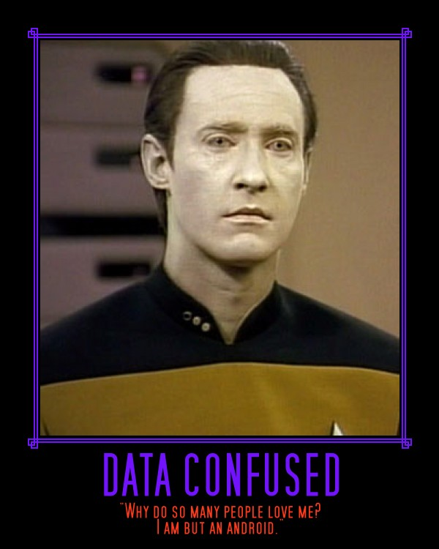
What is data anyways?
Files
(i.e. .txt, .binary, .csv )?
Programming Objects
(i.e. .tuples, arrays,
hashMaps, dicts )?
Variables and their distribution
(i.e. X, P(X))?
Notes:
Do the demo as well

Slide 4
What is data anyways?
For now we’re going
to focus on this meaning
of data.
Variables and their distribution
(i.e. X, P(X))?
Notes:
Do the demo as well

Slide 5
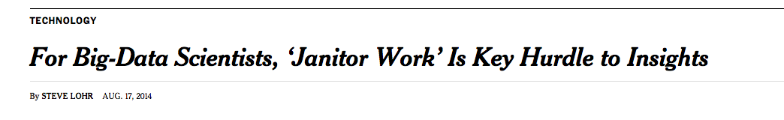
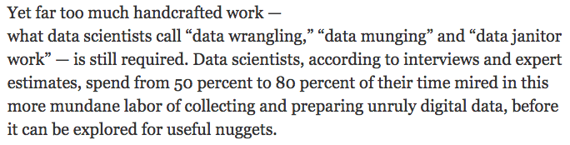
Something you should know
Source:http://www.nytimes.com/2014/08/18/technology/for-big-data-scientists-hurdle-to-insights-is-janitor-work.html?_r=0
Notes:
Do the demo as well

Slide 6
Think optimistically
Don’t think of data preparation as a nuisance or pejorative
Notes:
Do the demo as well

Slide 7
Data prep => success
Process flow of almost all Data Science tasks
Data
Collection & Prep
Modeling
&
Analysis
Communication
&
Application
This is the sexy part,
getting all the research and attention from competitions
…
and it is indeed fun!
Notes:
Do the demo as well

Slide 8
Data prep => success
Process flow of almost all Data Science tasks
Data
Collection & Prep
Modeling
&
Analysis
Communication
&
Application
These are what make you a good and effective data scientist however
Notes:
Do the demo as well

Slide 9

2 key questions
Where did my data come from?
What does it look like?
Notes:
Do the demo as well

Slide 10
Always know the source
Where did my data come from?
Internal ETL processes
Production sampling
Web scraping/ API
Survey/Panel
Notes:
Do the demo as well

Slide 11

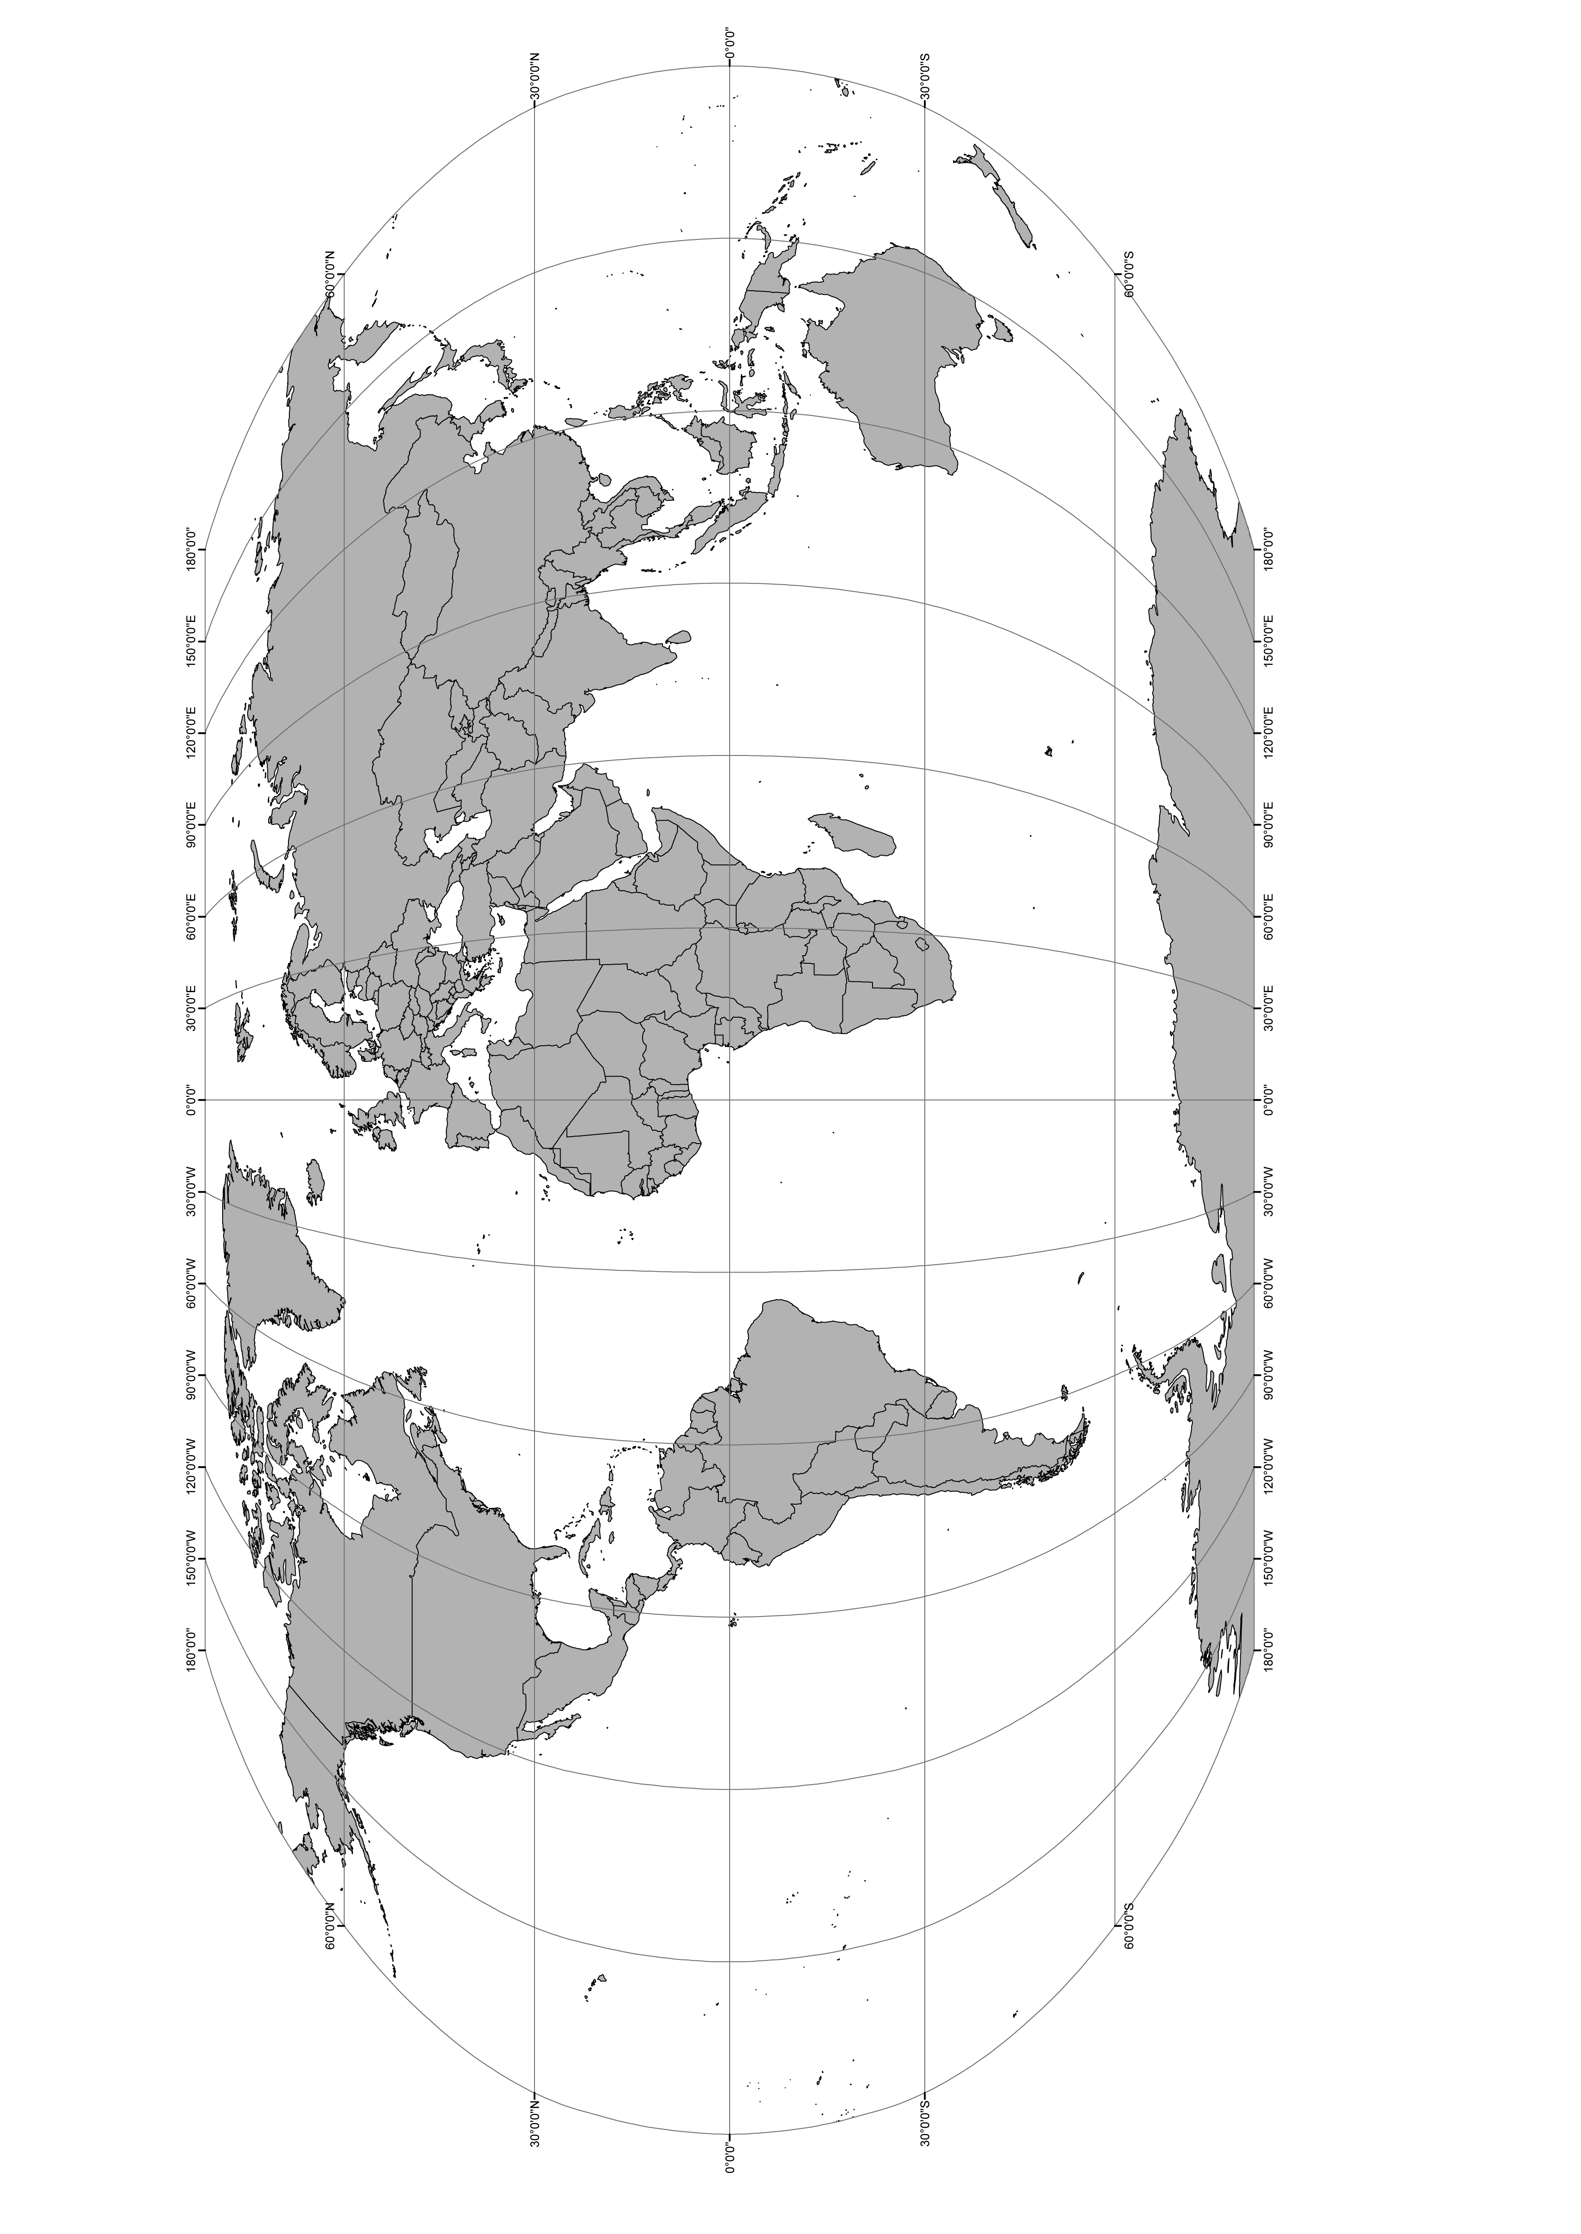
Common data flow
The World
The System
The Scientist
Production Code /
Interface
Internal
DB, Log,
File System
Challenges we often face:
Often the data scientist doesn’t write/own the code that writes the data. (Selection Bias, Unknown Unknowns)
The system intervening on the world changes the nature of the data we collect from it. (Selection Bias, Negative Feedback Loop)
We have no control often of data that streams into the system. (Concept Drift & Selection Bias)
Notes:
Do the demo as well

Slide 12
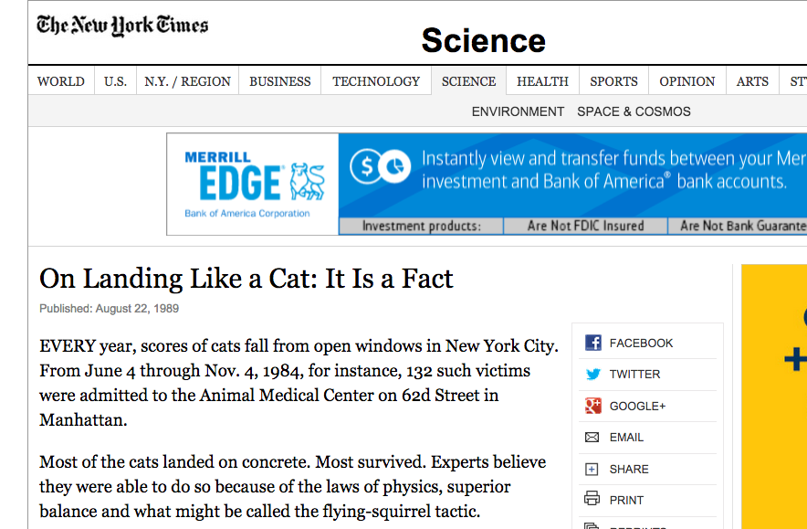
Note, the data technically doesn’t lie. Most cats did indeed survive. And the longer the fall, the greater the likelihood of survival (in the data).
source: http://www.nytimes.com/1989/08/22/science/on-landing-like-a-cat-it-is-a-fact.html
https://www.youtube.com/watch?v=TGGGDpb04Yc
Notes:
Do the demo as well

Slide 13
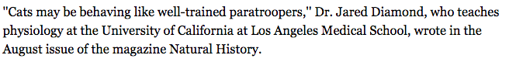
occam’s razor quiz
Conclusion derived from the data…
Explanation 1 (per the article):
Explanation 2 (per a reasonable statistician):
Nobody brings their dead cat to the hospital, therefore this data suffers from selection bias. Cats that are clearly alive after a fall are more likely to be brought to the hospital, and more likely to survive. It is likely that the ambiguity of a cat’s condition decreases with the height of the fall. Cat’s are either obviously dead or obviously alive, which explains the trend in the data.
Notes:
Do the demo as well

Slide 14
Selection bias
Every analysis starts by drawing a data sample S from a population D.
Each instance is characterized by a set of features (X,Y)
If being in the sample S is independent of X and Y, the sample is unbiased:
i.e. P(S|X,Y)=P(S)
Else the sample is biased: i.e. P(S|X,Y)≠P(S)
Source:
Zadrozny, Bianca. "Learning and evaluating classifiers under sample selection bias." Proceedings of the twenty-first international conference on Machine learning. ACM, 2004.
Notes:
Do the demo as well

Slide 15


Selection bias – toy examples
Pop.
1
2
3
Notes:
Do the demo as well

Slide 16


Selection bias – toy examples
1
2
3
P(S1) = 0.5
P(S1|R) = 0.75
P(S1|B) = 0.25
P(S2) = 0.5
P(S2|R) = 0.5
P(S2|B) = 0.5
P(S3) = 0.5
P(S3|R) = 1
P(S3|B) = 0
Notes:
Do the demo as well

Slide 17
Selection bias – implications
Selection bias within data affects generalizability of results and potentially the identifiability of model parameters.
Generalizability:
Does your model represent the population at large?
Does your prediction match the production results?
Is your statistic representative of the greater population?
Identifiability:
Can you learn a model, parameter or statistic given the data at hand?
e.g,
in previous example, sample 3. Let’s assume we want to know the average sales for blue figures, i.e., E[Sales|B]. Because P(Samp3|B)=0, we can not learn this parameter from the data.
Notes:
Do the demo as well

Slide 18


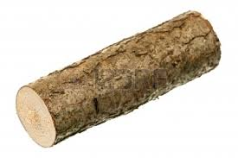
Selection bias – example 1
This is a case of selection bias happening because of technical constraints.
1. A user comes into the system , uid=10000
2. Query Cassandra to get user’s data:
3. Log user event and Cassandra output to a research database
Now what could go wrong?
Notes:
Do the demo as well

Slide 19
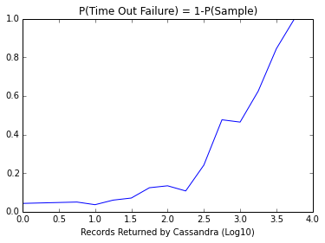
Selection bias – example 1
It turns out, when you have a user with a lot of data attached to it, the Cassandra output is too big and it clutters up the network. The result is that the
system is more likely to time out and kill the query, and the user never gets logged.
Its pretty clear that P(S|X)≠P(S), where X is the number of records attached to the user.
Notes:
Do the demo as well

Slide 20

Selection bias – example 2
Sometimes, selection bias is almost intentional, and is a rational decision caused by business and economic factors.
Credit Risk Modeling
Goal: Predict P(Default in 6 mo’s | Application Data)
Method:
Sample new credit card users, log app data
Observe 6 months, log if user defaults
Build a predictive model on sampled observations
Now what could go wrong?
Notes:
Do the demo as well

Slide 21
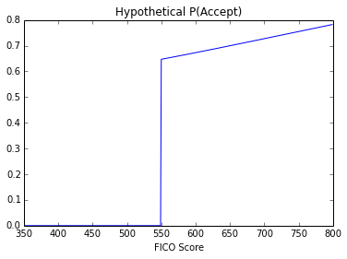
Selection bias – example 2
Q&A:
What is P(Sample|Fico<550)?
What implication does this have on model building?
Is it worth it?
Notes:
Do the demo as well

Slide 22
Selection bias – example 2
The scenario here is similar to a Logistic Model Tree, but where a portion of the data is missing:
FICO Score
<550
>=550
P(Y|FICO<550)
P(Y|FICO>=550)
We have no data in this region, so it is technically not identifiable.
If the model is truly linear, we can extrapolate to this region, but that could be an expensive assumption!
We have the data to estimate this,…
but we can’t generalize to the entire population.
Notes:
Do the demo as well

Slide 23
Selection bias – what to do
Selection bias is one of the biggest realities of production system data collection. What can you do about it?
Avoid It.
Adjust It.
Expect It.
Design and use random sampling schemes as much as possible.
In many cases you can statistically adjust for selection bias by weighting
examples by 1/P(Samp|X) or Heckman Correction. In some cases your models
will be fine (i.e., Logistic Regression w/ full data support).
Whether by design or accident, selection biases are likely to occur. Its always
important to anticipate it and prepare for how it might affect your analysis.
Notes:
Do the demo as well

Slide 24


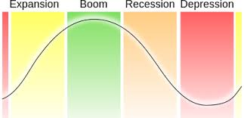
And on to concept drift
aka. Non - Stationarity
Defined simply as P(X) or P(Y|X) that changes over time, and is almost a fact
Of life.
Example causes are…
Seasonality
Promotions
(Exogenous Shocks)
Economic Cycles
Notes:
Do the demo as well

Slide 25
Simple illustration
T1 (w/ TV Campaign)
T2 (No Campaign)
T3 (No Campaign)
We built a model here, to predict sales as a function of a user’s history and demos.
At the end of T2:
Should we build a new model?
If yes, what data should we use?
Notes:
Do the demo as well

Slide 26
Simple illustration
Should we build a new model?
We have proof that the distribution of transactions has changed, suggesting the underlying driver of purchase is different without the campaign. We know that T3 will look more like T2 than T1, so we probably should rebuild.
2. If yes, what data should we use?
We can pull both datasets and compare models. If models are very similar, pool data.
Otherwise, it’s a balance between having more data and having the right data.
Notes:
Do the demo as well

Slide 27
Concept drift takeaways
Monitor predictive performance
Retrain as often as possible
Test balance between data recency and data volume
You don’t know future distributions, but model predictive performance should tell you when changes are happening.
The simplest way (in theory) to deal with an out-of-date model is to build a new one.
This ties back to the classic bias-variance tradeoff, which is at the heart of
many design decisions in data science.
Notes:
Do the demo as well

Slide 28
The shape of your data
2. What does it look like?
Distribution
Feature types
Missing values/outliers
Notes:
Do the demo as well

Slide 29
distributions
This isn’t a probability course, but data can usually be characterized by its distribution and associated statistics.
In reality though, empirical data rarely conforms to standard probability distributions. These are still useful for simulations for smoothing/regularization using various Bayesian methods.
Notes:
Do the demo as well

Slide 30
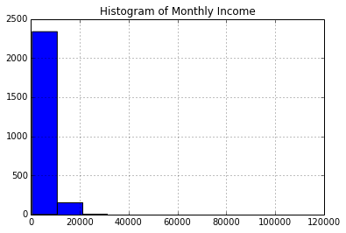
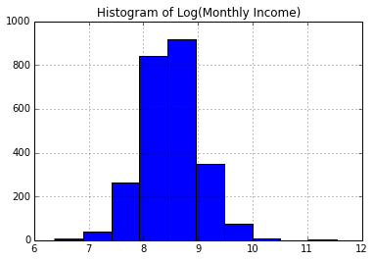
Empirical distributions
Most data comes in as is and it doesn’t always matter what you call its distribution…
but its still useful to understand its shape. The histogram is a great tool for this.
Notes:
Do the demo as well

Slide 31
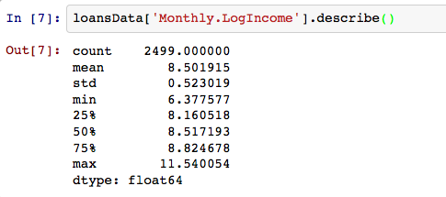
Empirical distributions
It is often very useful to know the distributional statistics of your data…
Notes:
Do the demo as well

Slide 32
Types of features
Most variables fall under four basic categories
Variable
Numeric
Categorical
Continuous
Discrete
Ordinal
Nominative
Notes:
Add some slides about common feature transformations

Slide 33
Implications of feature type
Modeling
Every algorithm has requirements on what type of data can be used as an input. I.e., regression based methods require numeric or binary variables, while tree methods can accept any type.
Often times you can ‘cheat’ linear models by transforming the data correctly (more on this in later lectures).
Analysis/Exploration
Distributional statistics aren’t defined on categorical data, but you can use categorical data to compare statistics across category groupings.
Notes:
Do the demo as well

Slide 34
A rose by any other name
Independent of type, it is also important to classify a variable according to how it will be used or analyzed.
Machine
Learning
Common
Symbols
Statistics
Thing you want
to predict
Dependent
Variable
Target
Variable
Y, f(X)
Things you use
to predict
Independent
Variable
Feature
X
NB: Admittedly, I often use these terms interchangeably.
Notes:
Do the demo as well

Slide 35
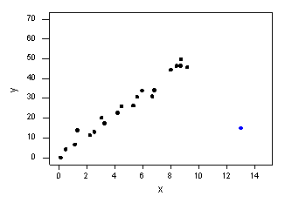

Data cleaning
Beyond general data exploration and transformations, one usually wants some degree of data cleanup, looking for outliers and missing values.
Outliers are often the result of erroneous data collection or processing. Not only are they a good clue for data processing QA, but they can have severe influence on model estimates or summary statistics.
Missing values can indicate processing/collection errors. When present in the data (as either null, NA or “”), they can break a lot of modeling algorithms.
Notes:
Do the demo as well

Slide 36
Handling outliers/nulls
What should one do when faced with these issues? The easiest answer in data science is it depends…
If missing/bad at random…
If the occurrence is rare, delete observations (most extreme)
Can also impute/replace with average for that feature.
Otherwise…
Impute with some constant (usually the average), create a dummy variable to indicate missing/bad
Exploit multi-collinearity, i.e., use a model to estimate E[Missing Val|X].
Notes:
Do the demo as well

Slide 37
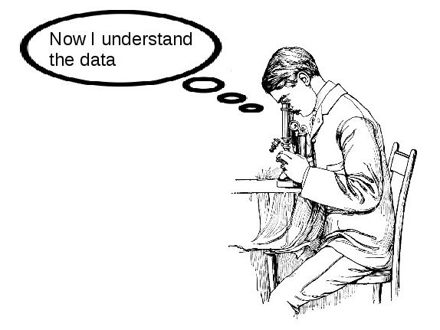
Notes:
Do the demo as well

